Slide 1
Streaming Data Processor
Pravin Y Pawar

Slide 2
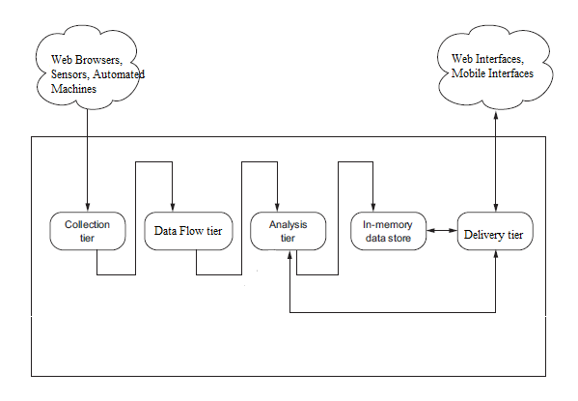
In-flight Data Analysis
Streaming data
always in motion
persisted only in few use cases otherwise just flowing through components present in the system
Altered version, original concept : Andrew G. Psaltis

Slide 3
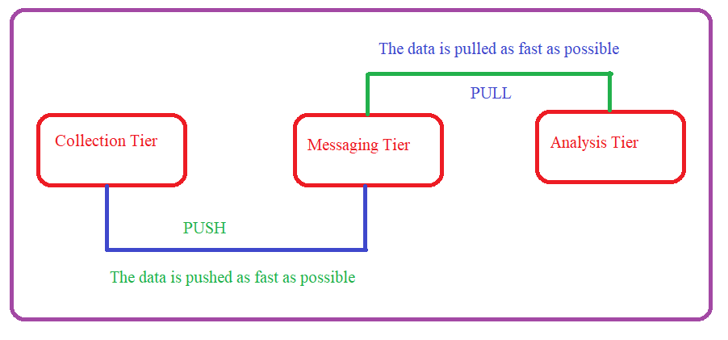
Data Push – Pull Mechanism
Collection tier pushes the data into the messaging tier
Analysis tier pulls the data from the messaging tier
As fast as possible
Key point – Analysis tier should be able to cope up with Collection tier
Altered version, original concept : Andrew G. Psaltis

Slide 4
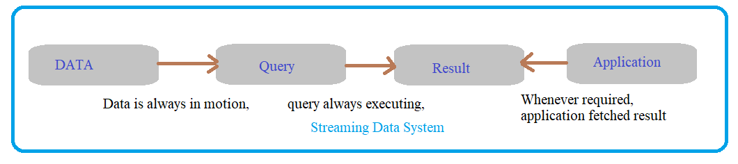
Continuous Query Model
Process of query execution in Streaming system
Continuously collect the streaming data from external system
Phrase a continuous query like fetch sum(sales)
Register the continuous query to determine the sum(sales)
Query will be executing continuously either based on events arrival or after certain time period
Fetch the results, analyze it and take decision based on it

Slide 5
Distributed stream processing architecture
A Generalized Architecture
Usually has three common parts :
Driver / Manager to which the program is submitted for the execution
Nodes in cluster which actually executes the program
Data sources are input to the programs

Slide 6
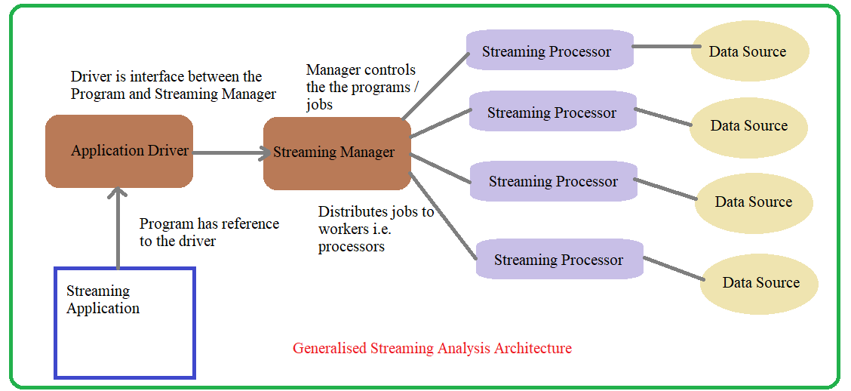
Distributed stream processing architecture(2)
General Streaming analysis architecture

Slide 7
Distributed stream processing architecture(3)
General Streaming analysis architecture components
Application
program that is interested in doing the analysis of streaming data
Application Driver
Interface between the application and streaming system
Communicates with streaming manager
Streaming Manager
Controls the life cycle of the job
Gets actually work done from the workers
Stream Processor / Workers
Actually does the job execution
Gets data from the data sources

Slide 8
Thank You!
In our next session: Storage for Streaming Data

